Slide 1


Heap sort
Name : Ramoliya Mansi Jayeshbhai
Roll No : 89
Batch : S3
Enroll No : 21002170110151
Sub : Data Analysis and Algorithm
Branch:CE

Slide 2
What is heap sort ?
Heap sort is a comparison-based sorting technique based on Binary Heap data structure. It is similar to the selection sort where we first find the minimum element and place the minimum element at the beginning. Repeat the same process for the remaining elements.

Slide 3
Advantages of heap sort…
Efficiency – The time required to perform Heap sort increases logarithmically while other algorithms may grow exponentially slower as the number of items to sort increases. This sorting algorithm is very efficient.
Simplicity – It is simpler to understand than other equally efficient sorting algorithms because it does not use advanced computer science concepts such as recursion

Slide 4
Algorithm:-
heapify(array) Root = array[0]
Largest = largest( array[0] , array [2 * 0 + 1]/ array[2 * 0 + 2]) if(Root != Largest) Swap(Root, Largest)
First convert the array into heap data structure using heapify, than one by one delete the root node of the Max-heap and replace it with the last node in the heap and then heapify the root of the heap. Repeat this process until size of heap is greater than 1.

Slide 5
void heapify(int arr[], int n, int i)
{
// Find largest among root, left child and right child
int largest = i;
int left = 2*i+1;
int right = 2*i+2;
if (left<n && arr[left]>arr[largest])
{
largest=left;
}
if (right<n && arr[right]>arr[largest])
{
largest = right;
}
// Swap and continue heapifying if root is not largest
if (largest!= i)
{
swap(&arr[i], &arr[largest]);
heapify(arr, n, largest);
}
}
Heapify function

Slide 6
Complexity of heap sort :=
Heap Sort has O(nlog n) time complexities for all the cases ( best case, average case, and worst case).
In heap sort, we build a heap and then extract the root element one by one, after every extraction we make the last element as root and then run the heapify() procedure. The heapify procedure takes O(logn), time.
Also, we do this heapify procedure n times(one time for each element), so time complexity becomes O(nlogn).

Slide 7
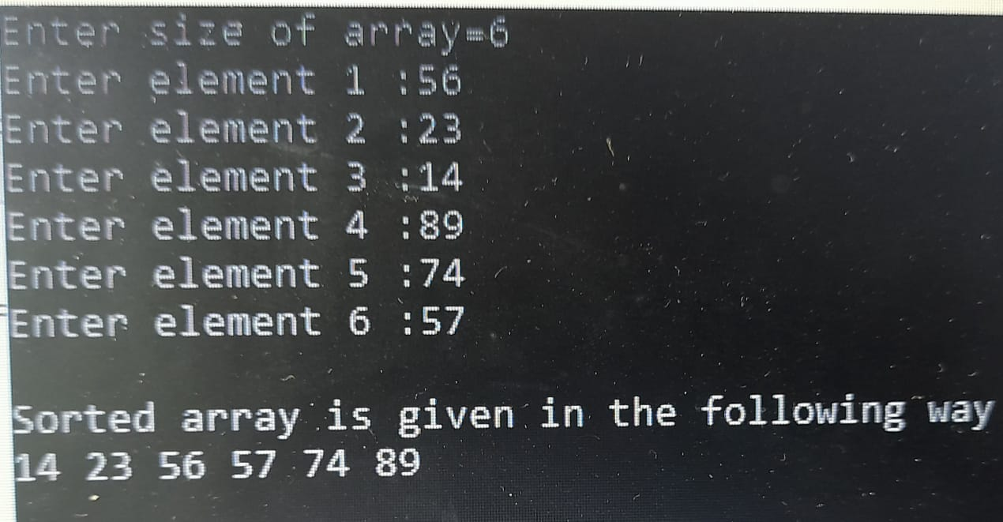

Output :

Slide 8
Thank you…

